Slide 1
Data Models

Slide 2
Entity-Relationship Model
An ER Model is a high level description of the data and the relationships among the data, rather how data is stored. Some features of E-R Model are:
The E-R diagram used for representing E-R Model can be easily converted into relations(tables) in relational model.
The E-R Model is used for the purpose of good database design by the database developer so as o use that data model in various DBMA.
It is a top-down approach to database design.
It gives the precise understanding of the nature of data and how it is used by an enterprise.
It is very simple, non technical, free of ambiguities and easy to understand by various types of users, programmers and designers because a specific standards are used for their representation.

Slide 3
E-R Diagram
Entity relationship model defines the conceptual view of database.
It works around real world entity and association among them.

Slide 4
E-R Model Terminology
ENTITY
A real-world thing either animate or inanimate that can be easily identifiable and distinguishable.
Objects about which information can be stored.
For example, in a school database, student, teachers, class and course offered can be considered as entities.
Properties of Entity :
Entity is represented by set of properties called attributes.
Entity is atomic and cannot be broken down into smaller pieces.
Entity is an instance of entity type so it is represented in E-R diagrams a rectangular box enclosing its name.
ENTITY TYPE
An entity type is a collection of entities that have the same attributes but different values.
Properties of Entity Type:
An entity is an instance of entity type.
An entity type is identified by its name and properties.
An entity type is represented by ER diagram as a rectangular box enclosing the entity type.

Slide 5
ENTITY SET
An entity set is a collection of all instances of a particular entity type at any point of time in the database. Each entity set is referred by its name and attribute values.Its name is same as that of entity type.
ATTRIBUTES
Entities are represented by means of their properties, called attributes.
For example, a student entity may have name, class, age as attributes.
Properties of Attributes
The attributes of an entity should be unique.
The attributes should uniquely identify the entity.
The set of permitted values for each attribute is known as its domain from where its values are chosen.
An attribute of an entity is represented in ER diagram as an ellipse attached to a relevant entity by a line and labelled with entity name.

Slide 6
Types of attributes:
Simple attribute:
Simple attributes are atomic values, which cannot be divided further.
For example, student's phone-number is an atomic value of 10 digits.
Composite attribute:
Composite attributes are made of more than one simple attribute.
For example, a student's complete name may have first_name and last_name.
Derived attribute:
Derived attributes are attributes, which do not exist physical in the database, but there values are derived from other attributes presented in the database.
For example, average_salary in a department should be saved in database instead it can be derived.
For another example, age can be derived from data_of_birth.

Slide 7
Single-valued attribute:
Single valued attributes is the one that has only a single value for a particular entity.
For example: RollNo.
Multi-value attribute:
Multi-value attribute is an attribute that holds multiple values for a particular single entity.
For example, a person can have more than one phone numbers, email_addresses etc.

Slide 8
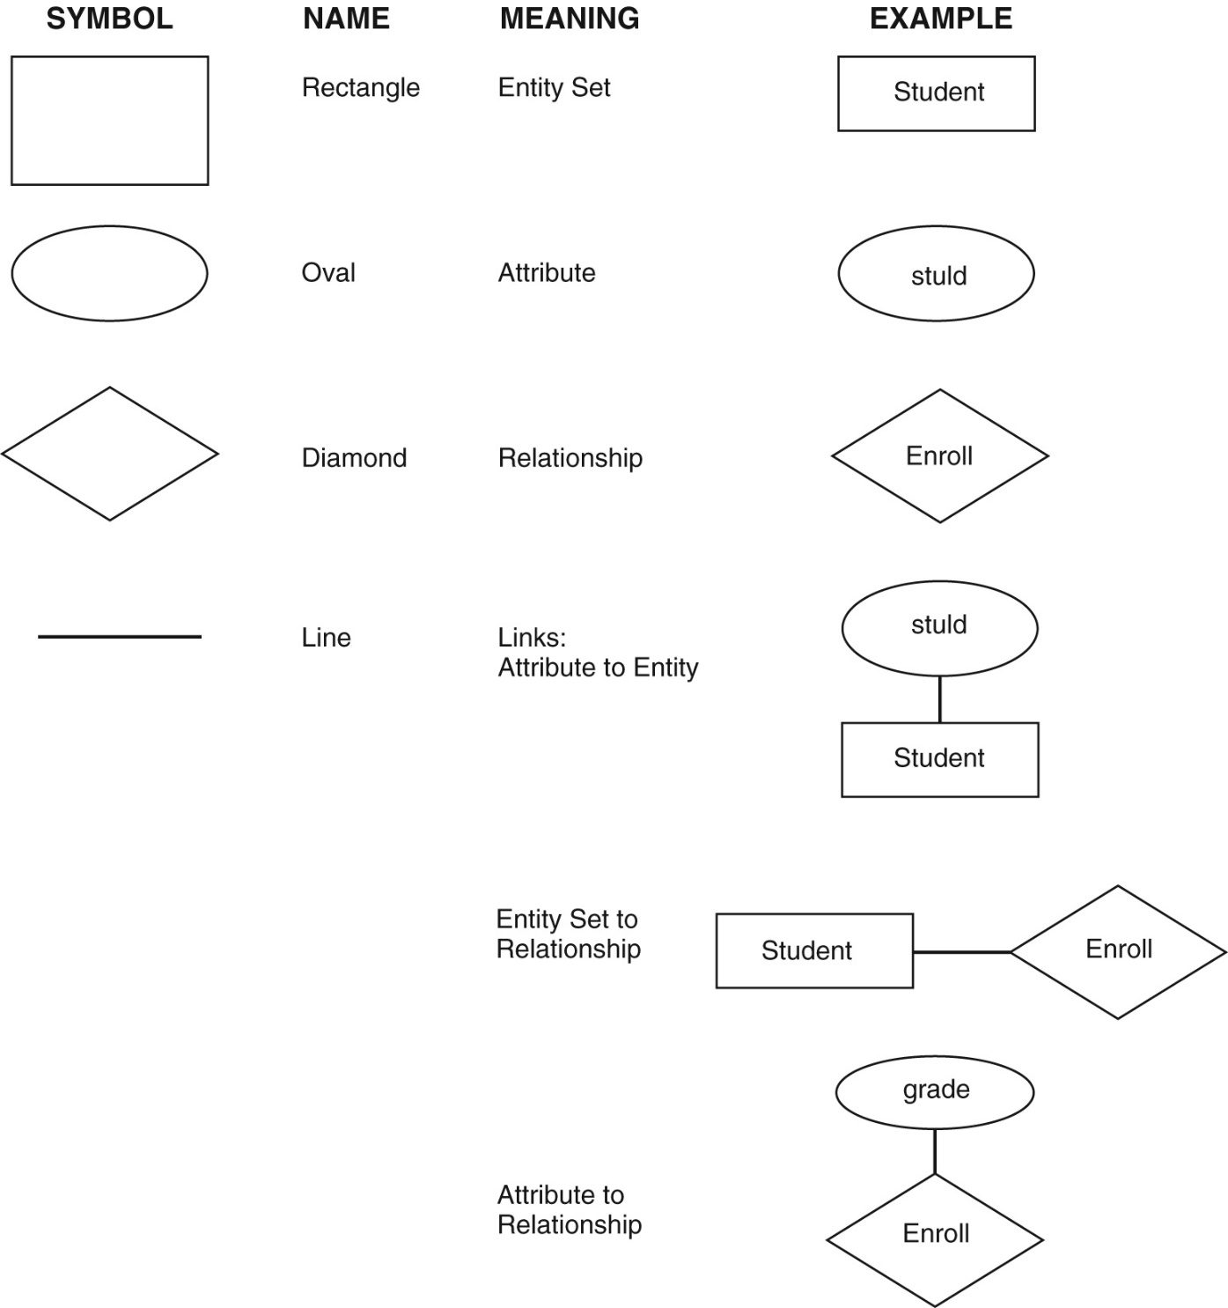
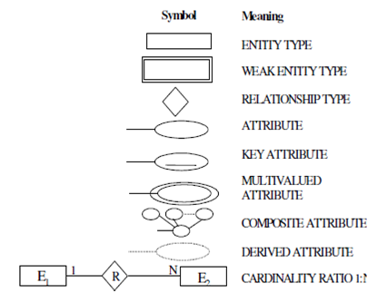

Slide 9
Relationship
The association between two or more entities is called relationship.
For example, employee entity has relation works_at with department
Relationship Set:
Relationship of similar type is called relationship set.
DEGREE OF RELATIONSHIP
The number of participating entities in an relationship defines the degree of the relationship or Total number of attributes or columns of a relation is known as the degree of the relation.
Unary – When association exists within a single entity type. The degree of unary relationship is 1. It is sometimes called as Recursive Relationship.
Binary - When association exists between two entity types. The degree of binary relationship is 2.
Ternary – When association exists among three entity types. The degree of ternary relationship is 3. It is rarely used in real world. If it exists, is should be decomposed into one or more binary relationships.
Quaternary - When association exists among four entity types. The degree of Quaternary relationship is 4.

Slide 10
Connectivity of Relationship
Connectivity of relationship means how many instances of one entity are associated with how many instances of other entity in a relationship. It describes the mapping of associated entity instances in the relationship.

Slide 11
Mapping Cardinalities:
Cardinality defines the number of entities in one entity set which can be associated to the number of entities of other set via relationship set.

Slide 12
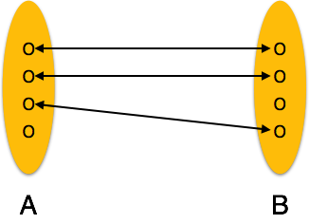
One-to-one(1:1): one entity from entity set A can be associated with at most one entity of entity set B and vice versa. 1:1 relationship occurs when an instance of entity type A is associated with exactly one instance of entity type B.
Eg- No student can do the same project and no student can do more than 1 project.

Slide 13
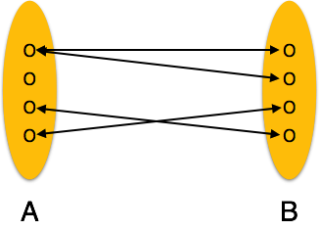
One-to-many(1:N): One entity from entity set A can be associated with more than one entities of entity set B but from entity set B one entity can be associated with at most one entity. 1:N relationship occurs when any one instance of entity type A is associated with N number of instance of another entity type B.
Eg- Relationship between Department and Faculty.

Slide 14
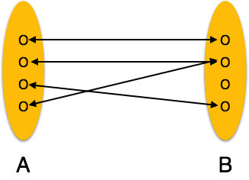
Many-to-one: More than one entities from entity set A can be associated with at most one entity of entity set B but one entity from entity set B can be associated with more than one entity from entity set A. N:1 relationship occurs when any N number of instances of entity type A is associated with atmost one instance of entity type B.
Eg- faculty are employed by department.

Slide 15
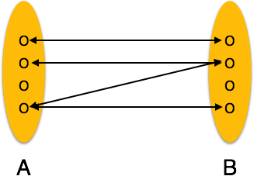
Many-to-many: one entity from A can be associated with more than one entity from B and vice versa. M:N relationship occurs when an instance of entity type A is associated with any number of instances of entity type B and instance of entity type B is associated with any number of instances of entity type A.
Eg- Author writes books.

Slide 16
ER Diagram Representation
Entity
Entities are represented by means of rectangles. Rectangles are named with the entity set they represent.

Slide 17
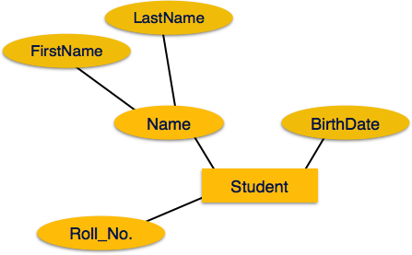
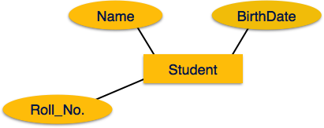
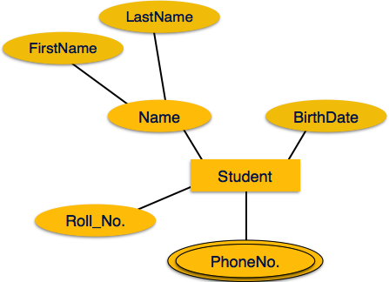
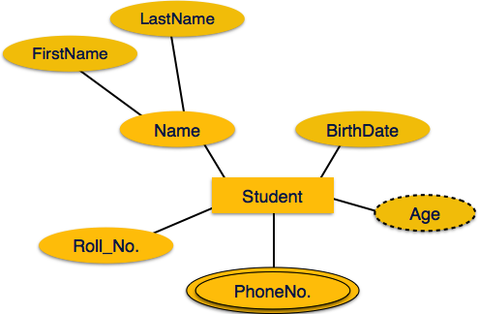
Attributes

Slide 18
Cardinality of Relationship
The total number of rows or tuples in a table is referred as Cardinality of a relation.
Cardinality of a relationship quantifies the relationship between entities by measuring how many instances of one entity type are related to a single instance of another.
The actual count of elements associated with the connectivity is called Cardinality.

Slide 19
Direction of Relationship
The direction of the relationship is the line connecting the two entities related to each other by a relationship.
The entity from where the relationship starts is the parent entity and the entity where the relationship ends is called the child entity.
The type of relation is determined by the line connecting the entities and the relationship components.

Slide 20
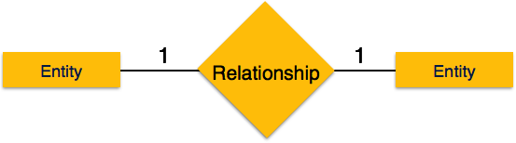
relationship and cardinality
One-to-one
When only one instance of entity is associated with the relationship, it is marked as '1'. This image below reflects that only 1 instance of each entity should be associated with the relationship. It depicts one-to-one relationship.

Slide 21

One-to-many
When more than one instance of entity is associated with the relationship, it is marked as 'N'. This image below reflects that only 1 instance of entity on the left and more than one instance of entity on the right can be associated with the relationship. It depicts one-to-many relationship.

Slide 22

Many-to-one
When more than one instance of entity is associated with the relationship, it is marked as 'N'. This image below reflects that more than one instance of entity on the left and only one instance of entity on the right can be associated with the relationship. It depicts many-to-one relationship

Slide 23

Many-to-many
This image below reflects that more than one instance of entity on the left and more than one instance of entity on the right can be associated with the relationship. It depicts many-to-many relationship.

Slide 24
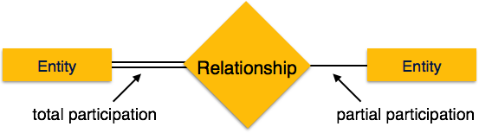
Participation Constraints
Total Participation: Each entity in the entity is involved in the relationship. Total participation is represented by double lines.
Partial participation: Not all entities are involved in the relation ship. Partial participation is represented by single line.

Slide 25
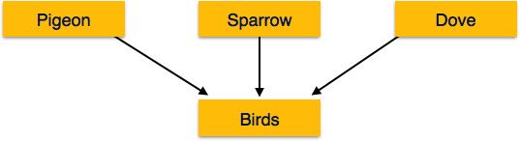
Generalization Aggregation
In generalization, a number of entities are brought together into one generalized entity based on their similar characteristics. For an example, pigeon, house sparrow, crow and dove all can be generalized as Birds

Slide 26
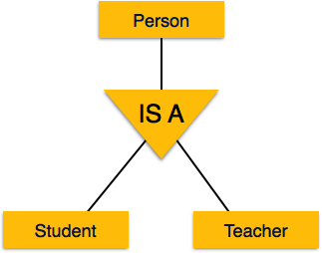
Specialization
Specialization is a process, which is opposite to generalization, as mentioned above. In specialization, a group of entities is divided into sub-groups based on their characteristics.
In a company, a person can be identified as employee, employer, customer or vendor based on what role do they play in company.

Slide 27
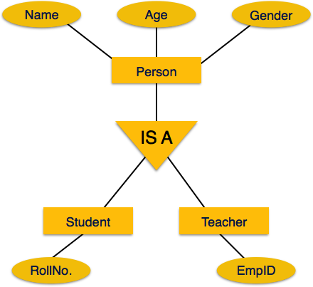
Inheritance
The important features of Generalization and Specialization, is inheritance, that is, the attributes of higher-level entities are inherited by the lower level entities.

Slide 28
Hierarchical Model
First hierarchical data model was designed by IBM and North American Rockwell in 1950.
Records are arranged in tree like structure, and are linked with their superior records on which they are dependent and to them which are dependent on them.
One to many relationship.

Slide 29
Operations on Hierarchical Model
Insert
Update
Delete
Retrieval of information

Slide 30
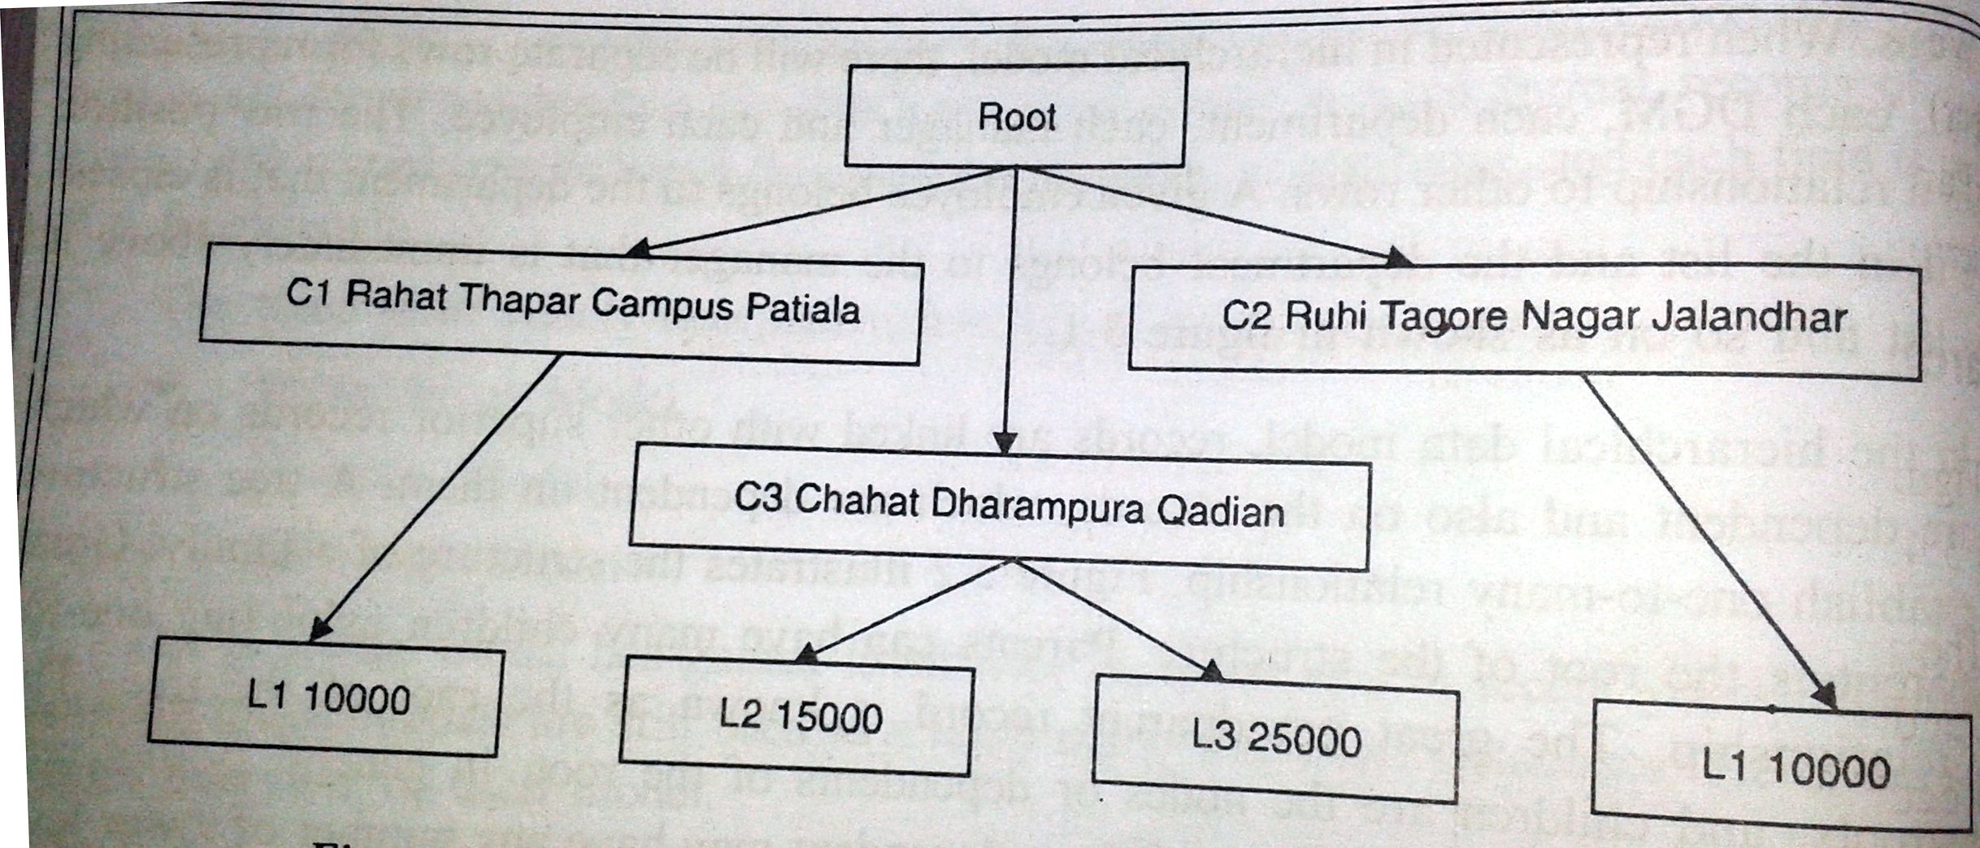

Slide 31
Advantages/ Disadvantages
Advantages:
Simplicity
Data security
Data integrity
Efficiency
Disadvantages
Implementation complexity
Database management problem
Lack of structural independence

Slide 32
Network Model
Network model replace the tree structure with graph.
Advantages:
Conceptual simplicity
Capable to handle more relationship typed: 1:N,N:N
Data integrity
Data independence
Database standards:
ANSI in 1970
Disadvantages :
System complexity
Operational anomalies
Absence of structural independence

Slide 33
